Slide 1

Lapsim Presentation
Erich Bahm, bahmerich@gmail.com
github.com/RensselaerMotorsport/LapSim

Slide 2
Agenda
What is Lapsim?
System Architecture
Track model
Subsystem models
Appendices
Questions

Slide 3
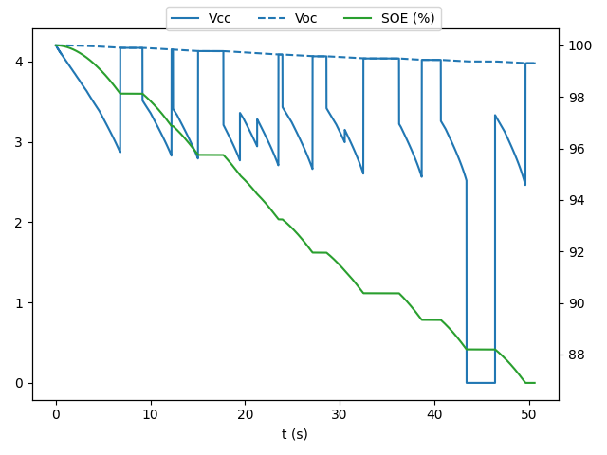
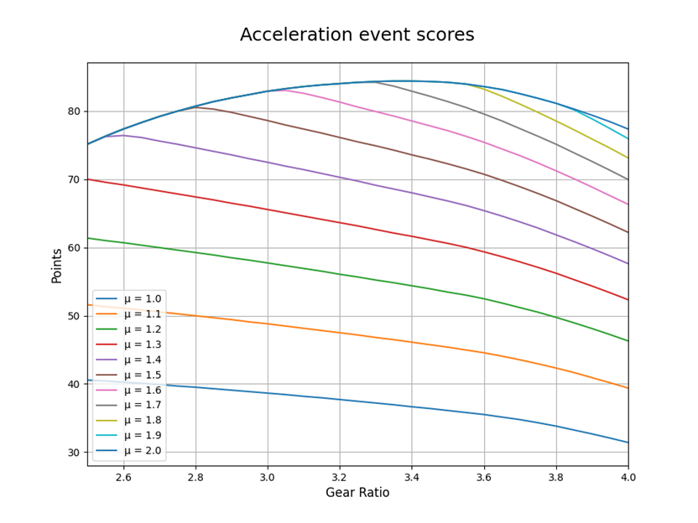
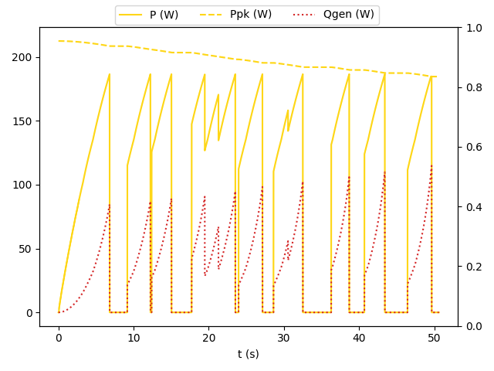
What is Lapsim?
In-house EV lap-time simulator for FSAE tracks used to compare high-level design decisions
Built-in battery model
Single track bicycle
Steady state load transfer
Simplified traction (F=Nμ)
100mm track divisions
Requires course accelerometer data
https://github.com/RensselaerMotorsport/LapSim

Slide 4
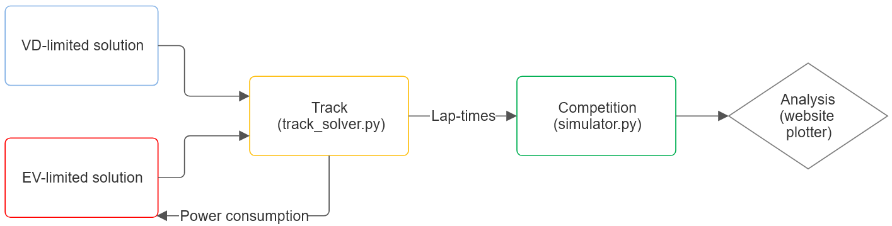
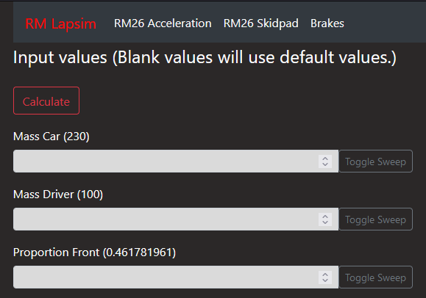
System architecture
VD-limited solution:
tires.py
aerodynamics.py
EV-limited solution:
hvbattery.py
drivetrain.py

Slide 5
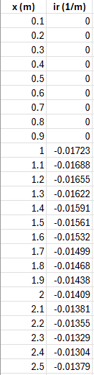
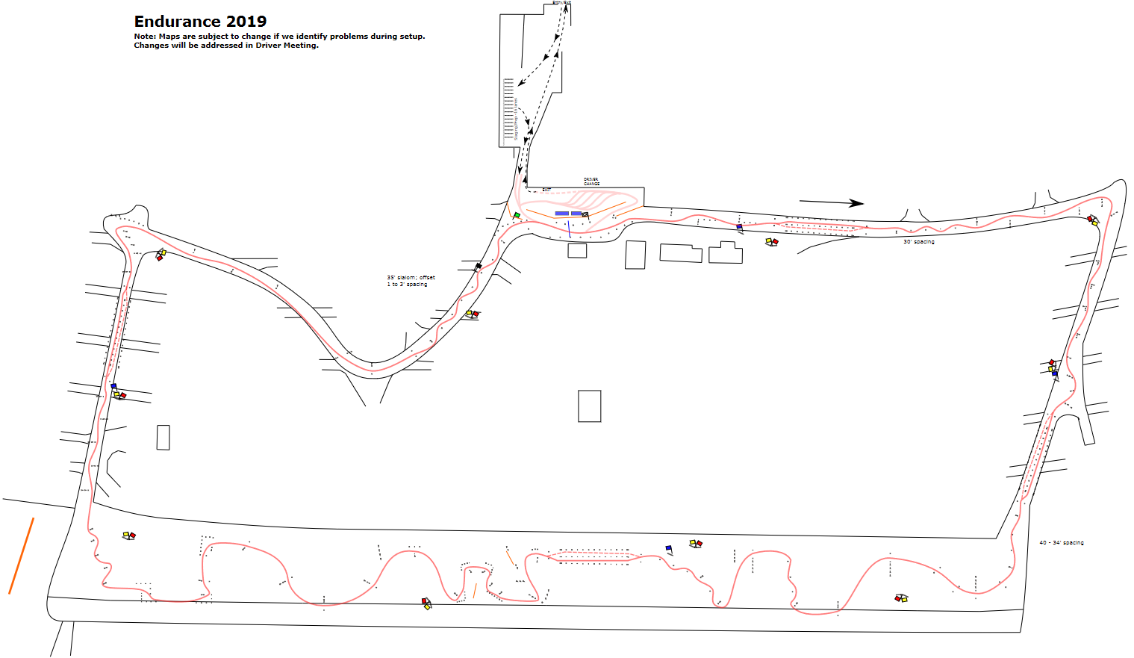
Track Definition
Track is defined as a set of positions (x) and inverse cornering radii (ir)
Increments of 0.1m
1. The track is created using accelerometer and GPS data
The “ideal” racing line is the line that the driver takes
Lapsim doesn’t calculate a racing line
2. This track is split into regions separated by apexes (list_apexes)
These apexes define the maximum speed on the track at that point
3. The model integrates through accelerating and braking to find the fastest completion
Track step 1 →
src\track_solver.py

Slide 6
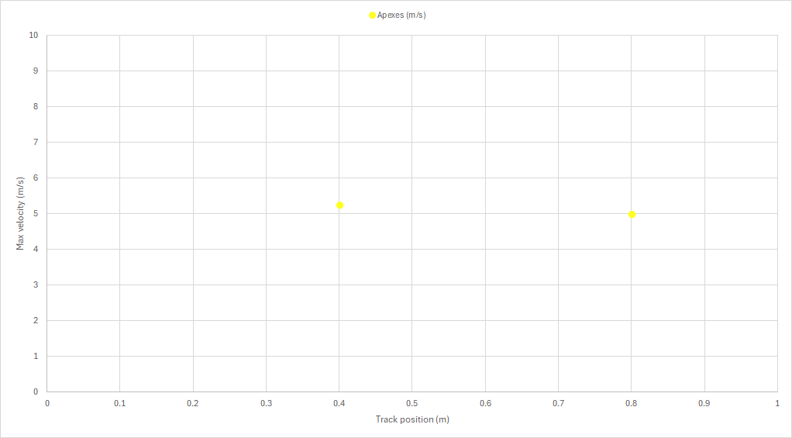
Track Apexes
At each position in the track, the maximum cornering speed is calculated
The troughs (where max velocity is a minima) are the apexes
Track step 2
src\track_solver.py

Slide 7
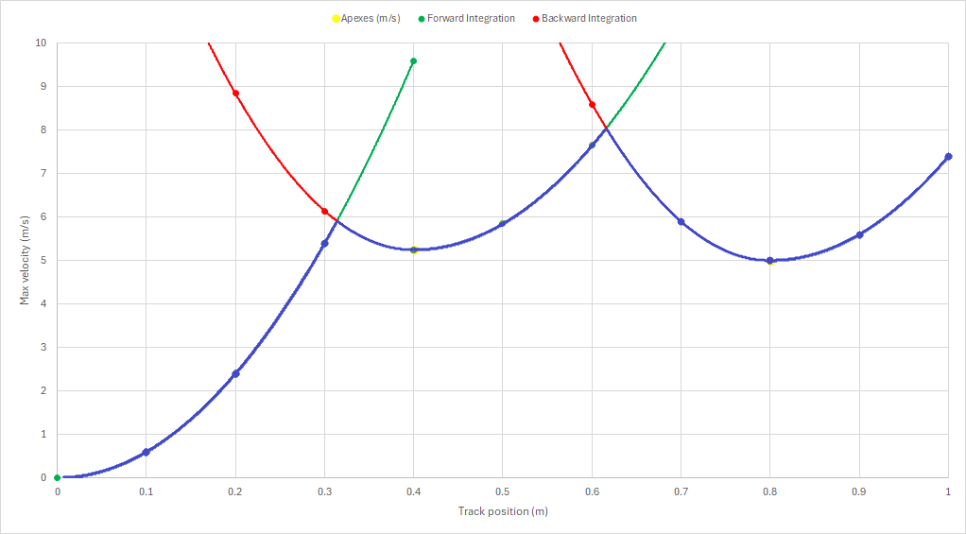
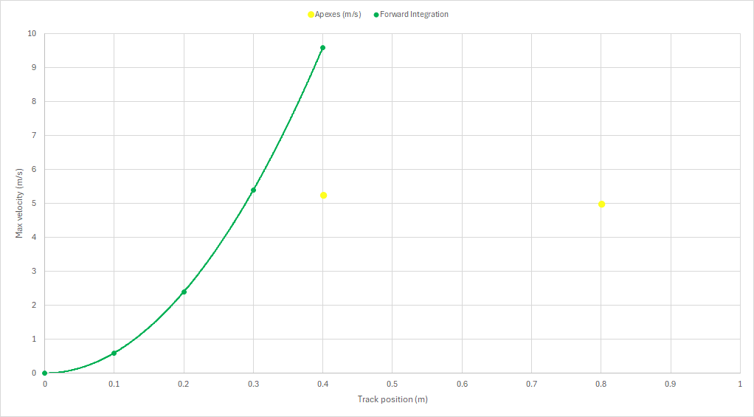
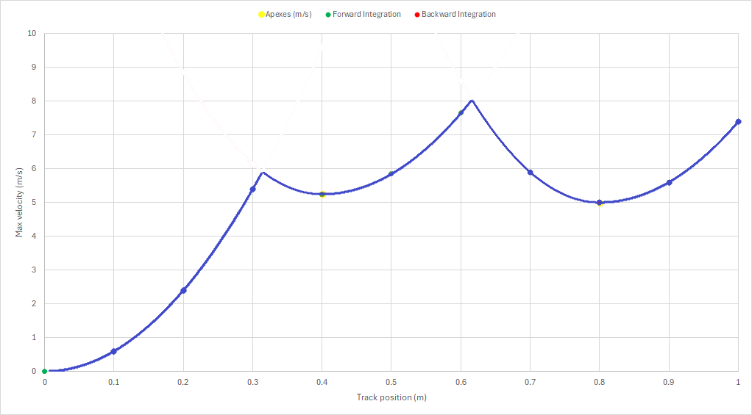
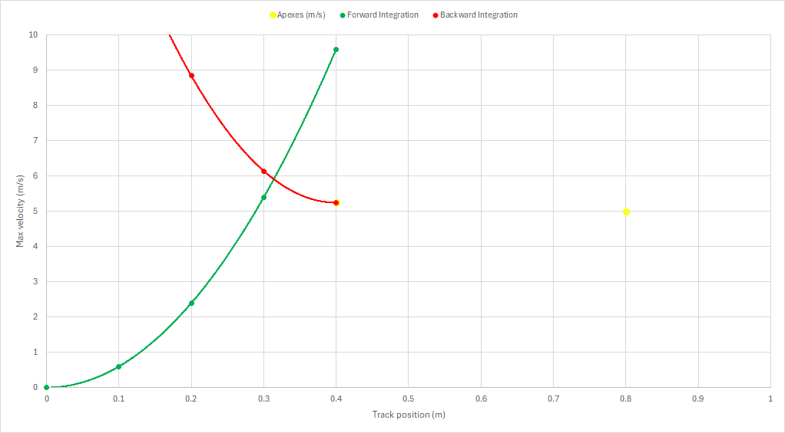
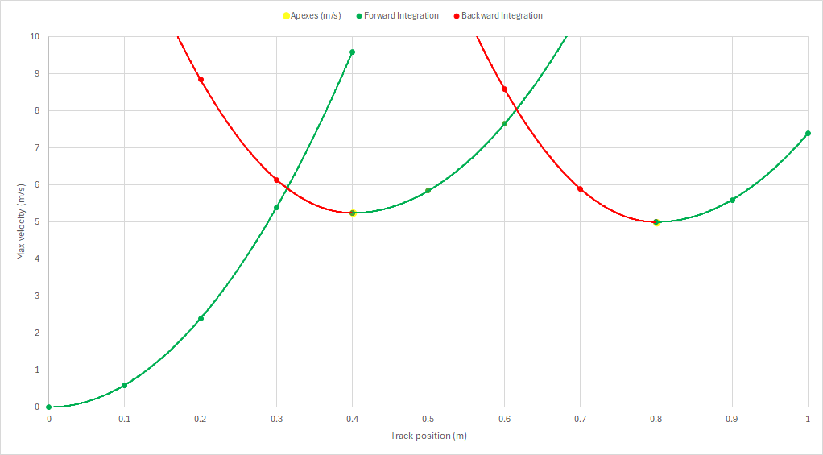
Track Apexes
Forward integration accelerates the car with the peak available power (VD and EV limited)
Backward integration decelerates the car with the peak available traction
These two integration methods combined give result in the track output
Track step 3 (Animated)
src\track_solver.py

Slide 8
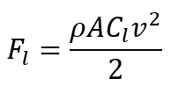
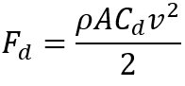
Aerodynamics
C_{l} and C_{d} values obtained through CFD, and experimentally
Frontal area measured using CAD
C_{l}: Coefficient of lift
C_{d}: Coefficient of drag
A: Car frontal area (m²)
ρ: Air density (kg/m³)
v: car longitudinal velocity (m/s)
calc_down_force
calc_drag_force
src\aerodynamics.py

Slide 9
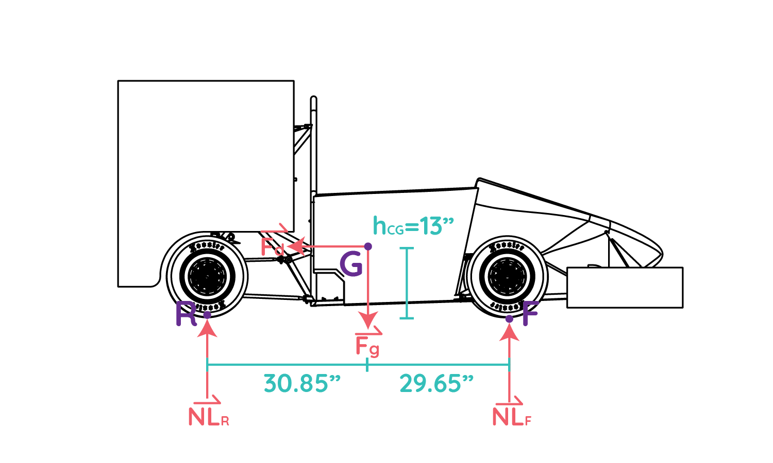
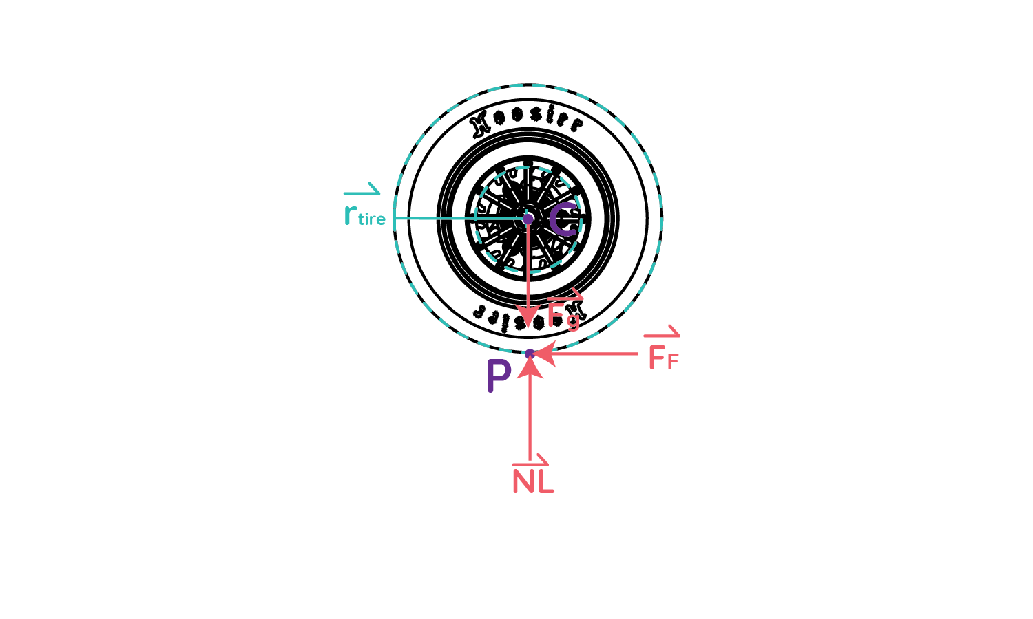
Suspension and Tires
src\tires.py

Slide 10
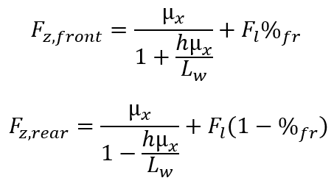
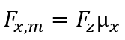
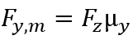
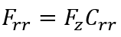
Suspension and Tires
𝜇_{x} and 𝜇_{y} obtained from track testing
CG position and wheelbase measured in CAD
Idealized to a bicycle model (2 total tires)
x: longitudinal, y: lateral
F_{z}: Vertical load - front or rear (N)
%_{fr}: Front weight proportion
h: CG height (m)
L_{w}: Wheelbase (m)
𝜇_{x}, 𝜇_{y}: Coefficient of friction
F_{x,m}, F_{y,m}: Max available traction (N)
calc_max_longitudinal force
calc_max_lateral force
calc_rolling_resistance
src\tires.py

Slide 11
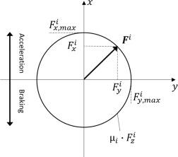
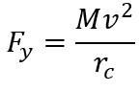
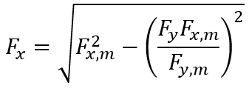
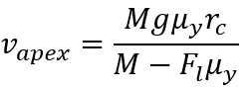
Suspension and Tires
Traction ellipse around corners
Longitudinal traction is reduced by lateral cornering load
Apex speed is defined as the max speed in the pure lateral case
M: Total mass of car, driver, and battery (kg)
g: Gravity (m/s²)
r_{c}: Corner radius (m)
F_{x}, F_{y}: Applied longitudinal, lateral forces (N)
v_{apex}: peak apex speed (m/s)
calc_apex_speed
src\tires.py

Slide 12
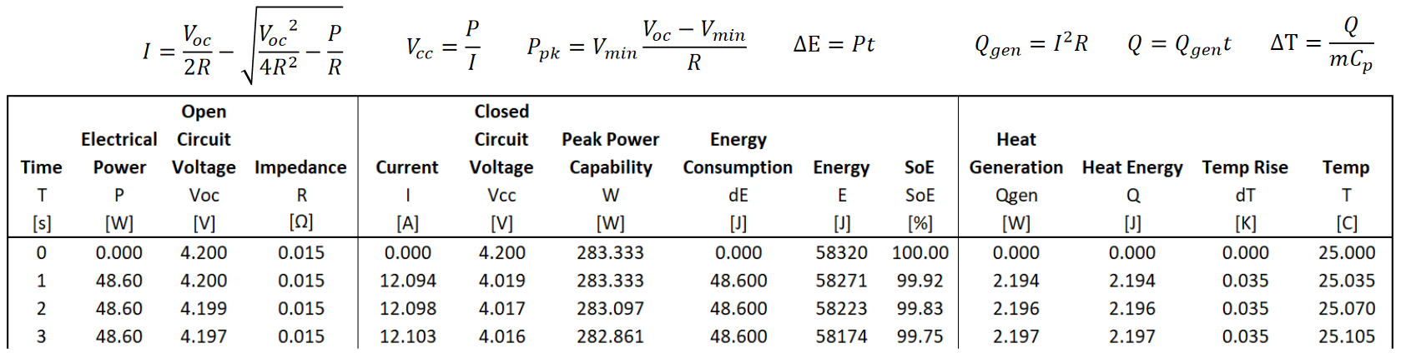
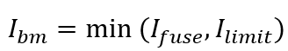
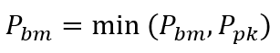
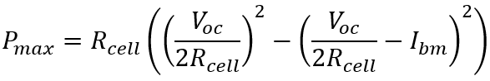
Accumulator
calc_apex_speed
src\hvbattery.py

Slide 13
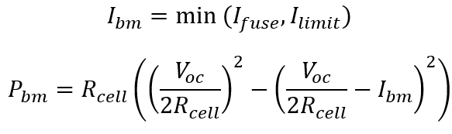
Accumulator
Fuse limit and current limits defined by rules and selected fuse
Cell resistance is not sensitive to temperature or current draw in current model
I_{bm}: Max battery output current (A)
P_{bm}: Max cell power output (W)
R_{cell}: Cell internal resistance (Ω)
calc_peak_power
src\hvbattery.py

Slide 14
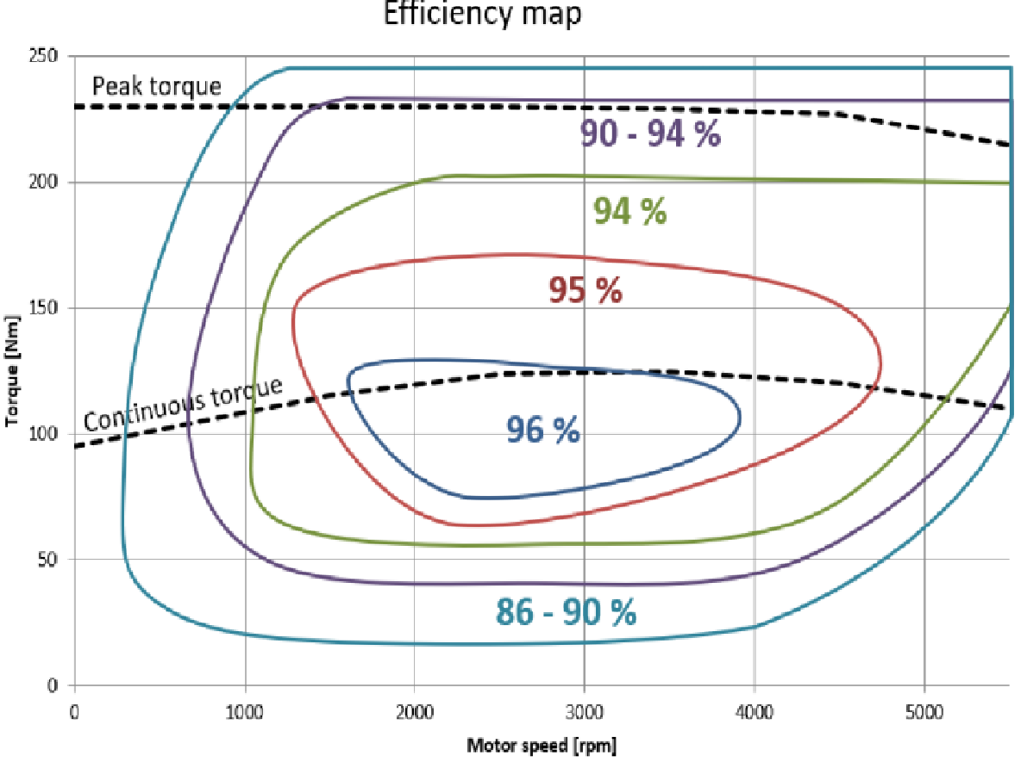
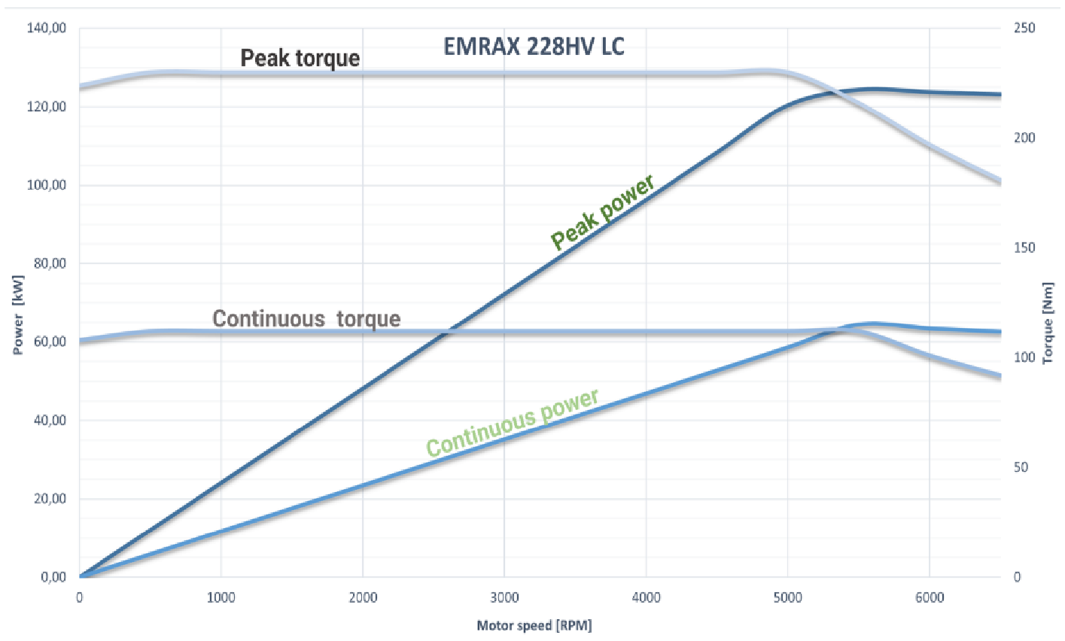
Drivetrain
src\drivetrain.py

Slide 15
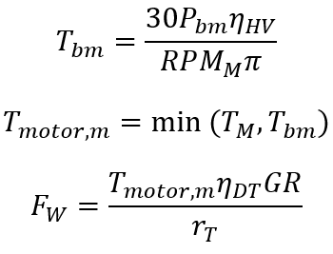
Drivetrain
Motor torque limit and efficiency defined by EMRAX manual
HV efficiency is power loss across wires
T_{motor,m}: Motor Torque limit (Nm)
GR: Sprocket gear ratio
F_{W}: Wheel force available (N)
calc_wheel_force
src\drivetrain.py

Slide 16
Appendix 1 - Battery modelling

Slide 17
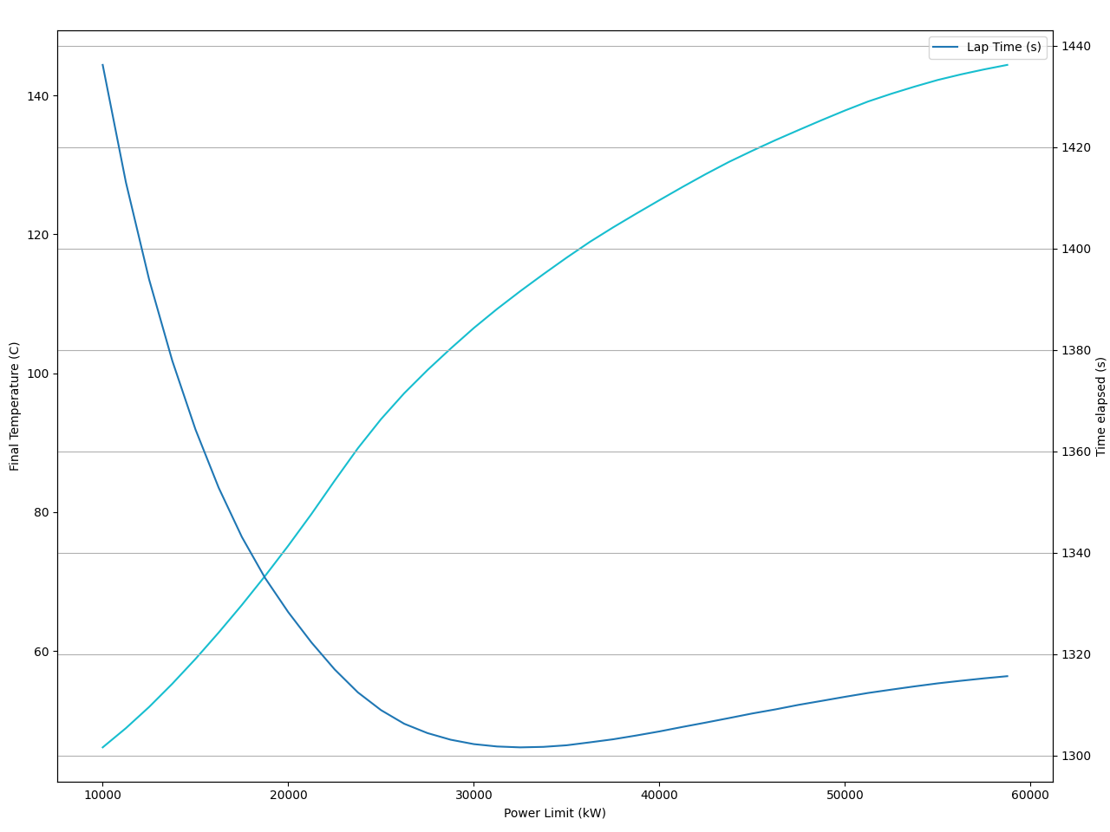
Appendix 2 - Power limiting

Slide 18
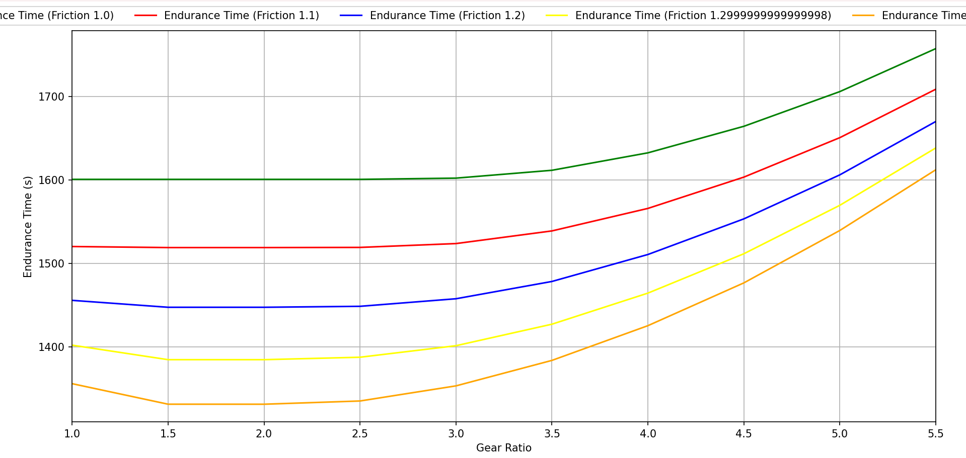
Appendix 3 - Gear ratio selection

Slide 19
Appendix 4 - Input list
Variable | Symbol | Units
mass_car | m_{C} | kg
mass_battery | m_{B} | kg
mass_driver | m_{D} | kg
wheelbase | L_{W} | m
CG_height | h | m
proportion_front | %_{fr} | –
CoF | μ | –
rolling_resistance_coeff | Crr | –
tire_radius | r_{t} | m
rho | ρ | kg/m³
Variable | Symbol | Units
Cd | C_{d} | –
Cl | C_{l} | –
A | A | m²
fuse_current | I_{fuse} | A
cells_series | S | –
cells_parallel | P | –
cell_resistance | R_{cell} | Ω
cell_capacity | C_{cell} | Wh
cell_thermal_capacity | C_{t} | J/K
cell_mass | m_{cell} | kg
src\data\rm28.json

Slide 20
Appendix 4 - Input list
Variable | Symbol | Units
peak_torque | T_{M} | Nm
constant_kv | K_{V} | rpm/V_{DC}
constant_kt | K_{T} | Nm/A_{rms}
induced_voltage | ε | V_{rms}/RPM
gear_ratio | GR | –
tractive_efficiency | η_{HV} | –
drivetrain_efficiency | η_{DT} | –
power_limit | P_{m} | kW
current_limit | I_{m} | A
src\data\rm28.json

Slide 21
Questions

Slide 22
Competition
src\competition.py

